Slide 1
Subqueries
DBMS-1002

Slide 2
Subqueries
What is a Subquery?
A query that appears WITHIN another query
In effect, asking the database to answer two or more questions at the same time
Where one question is answered and then the second question’s answer is dependent on the answer to the first question.

Slide 3
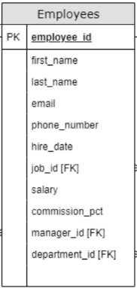
Subqueries - The Problem
Consider a problem
List all employees whose salary is above average
Without subqueries we would have two queries
Get the average salary from the employees table
Write down the average value and use it in a WHERE clause to show employees with higher salaries.

Slide 4
Subqueries - The Problem
Get the average salary from the employees table
The average is: 7327.916
Use this average to show employees with higher salaries
SELECT AVG(Salary) AS "Average Salary"
FROM Employees;
FIRST_NAME LAST_NAME
-------------------- ----------------
Steven King
Neena Kochhar
Lex De Haan
Alexander Hunold
Nancy Greenberg
….
SELECT first_name, last_name FROM Employees WHERE salary > 7327.916;

Slide 5
Subqueries - The Solution
Instead of two separate queries, we can use one:
Note: We put the subquery in brackets (parenthesis).
This subquery returns ONE column and ONE value.
We can compare against a single row value with a < type operator.
SELECT *
FROM Employees
WHERE salary > (SELECT AVG(Salary)
FROM Employees);
Outer Query
Inner Query (Subquery)

Slide 6
Subquery - Guidelines
When using subqueries (the inner query) follow these guidelines:
Use parenthesis.
Return a single column.*
Do not use ORDER BY.
May return either a single row or a set of rows:
A single row can be used with comparison operators: >, <, <=, >=, =, <>, IS NULL, IS NOT NULL
Multiple row results use collection comparisons such as: IN, NOT IN
* We will not use subqueries with multiple columns, but it can be done

Slide 7
Subquery - Single row result
Subqueries can return multiple rows or single rows.
In the next few slides we will see some examples of single row returns.
Note: We will generally use comparison operators for single row results:
>, <, <=, >=, =, <>, IS NULL, IS NOT NULL

Slide 8
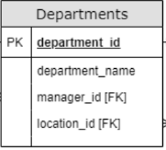
Subquery - Single Row Result
Example: Display the department name of: Neena Kochhar
Note: There is only one employee returned in the subquery. Which means we can use the = operator against a single value.
SELECT d.department_name
FROM Departments d
WHERE d.department_id =
(SELECT e.department_id
FROM Employees e
WHERE e.first_name = 'Neena'
AND e.last_name = 'Kochhar');

Slide 9
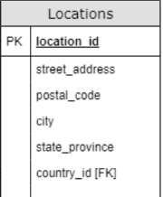
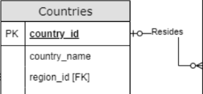
Subquery - Single Row Result
Example: Show all locations where the country name is: Canada
Note: There is only ONE country returned in the subquery, even if there are many locations for that country,
The inner query is run first, the returned country_id is compared against each location row (from the outer query).
SELECT *
FROM Locations l
WHERE l.country_id =
(SELECT c.country_id
FROM Countries c
WHERE c.country_name = 'Canada');

Slide 10
Subquery -Multiple Row Results
Now let’s see some examples of multiple row results returned from a subquery.
We will not be able to use comparison operators, instead we must use: IN and NOT IN.

Slide 11

Subquery -Multiple Row Results
Example: Display department names (there will be many), that have an employee with the last name of: Smith
MULTIPLE employees (rows) are returned from the subquery, causing the following error:
SELECT d.department_name
FROM Departments d
WHERE d.department_id =
(SELECT e.department_id
FROM Employees e
WHERE e.last_name = 'Smith');

Slide 12
Subquery - Many Row Result
To fix this issue, we replace the = operator with: IN
Note: When multiple rows are returned, we must use IN or NOT IN
This is because d.department_id must check against a collection of possible e.department_id values.
Only one result because all of the Smiths work for the same department!
SELECT d.department_name
FROM Departments d
WHERE d.department_id IN
(SELECT e.department_id
FROM Employees e
WHERE e.last_name = 'Smith');

Slide 13
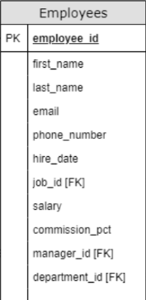
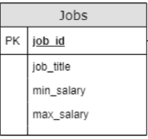

Subquery - Many Row Result
Example: Display the job titles of all the employees who do not have a 515 area code.
]
Note: There are many employees without a 515 area code. A collection of employees is returned in the subquery. The outer query uses this collection to filter out job rows.
SELECT j.job_title
FROM Jobs j
WHERE j.job_id NOT IN
(SELECT e.job_id
FROM Employees e
WHERE e.phone_number LIKE '515%');

Slide 14
Non-Correlated Subqueries
We have only seen examples of non-correlated subqueries.
The subquery portion is only executed ONCE and then the value is used by the outer query.
The subquery portion can be run independently from the outer query.

Slide 15
Non-Correlated Subquery Example
SELECT d.department_name
FROM Departments d
WHERE d.department_id IN
(SELECT e.department_id
FROM Employees e
WHERE e.last_name = 'Smith');
The database executes the inner query (subquery) first.
The outer query will execute second and compare each row’s department_id with the results of the inner query.
Note: We can execute the inner query without needing the outer query at all.

Slide 16
Correlated Subqueries
Correlated subqueries are queries where the subquery portion is executed many times.
The inner query (subquery) will have a reference to the outer query.
Therefore, the subquery portion CANNOT be run independently from the outer query.
Note: For this reason a Correlated Subquery always takes SIGNIFICANTLY LONGER to run than:
A query that does not have a subquery or
Has a non-correlated subquery.

Slide 17
Correlated Subquery
Example 1: Find any job, who has an employee with the max salary:
The database executes the outer query first.
The subquery cannot run first as the column j.job_id resides on the jobs table
The subquery contains an ‘Outer Reference’
For each row of the outer query, the inner query will execute!
The subquery contains an Outer Reference. Therefore it cannot execute on its own.
SELECT j.job_title
FROM Jobs j
WHERE j.max_salary =
(SELECT MAX(e.salary)
FROM Employees e
WHERE j.job_id = e.job_id);

Slide 18
Correlated Subquery Example 1
SELECT j.job_title
FROM Jobs j
WHERE j.max_salary =
(SELECT MAX(e.salary)
FROM Employees e
WHERE j.job_id = e.job_id);
Execution:
Outer query executes first bringing back a Job table row.
Inner query executes using the job_id value from the Job row.
MAX() is run on the subset of rows in the inner query.
The outer query Job table row is filtered based on the WHERE.
Repeat with the next Job table row.

Slide 19
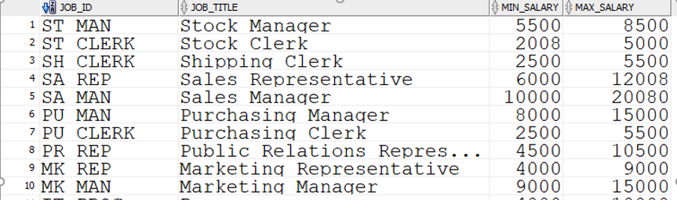
Correlated Subquery Example 1
This selects the max_salary from the Jobs table for each row.
i.e. 8500 for first row represents the max salary for Stock Manager’s
SELECT j.job_title FROM Jobs j WHERE j.max_salary =

Slide 20
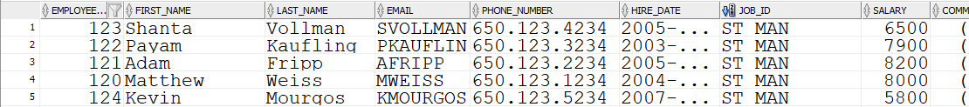
Correlated Subquery Example 1
SELECT j.job_title
FROM Jobs j
WHERE j.max_salary =
(SELECT MAX(e.salary)
FROM Employees e
WHERE j.job_id = e.job_id);
Selects those employees with the same job_id as the first job i.e ST_MAN (refer to last slide)

Slide 21
Correlated Subquery Example 1
SELECT j.job_title FROM Jobs j WHERE j.max_salary = (SELECT MAX(e.salary)
FROM Employees e
WHERE j.job_id = e.job_id);
Subquery selects the highest salary in this group.
i.e. 8200. So it becomes 8500=8200?
which is False so is not included in the result.

Slide 22
Correlated Subquery Example 1
Repeat the same process for the the remaining rows in the Jobs table (outer query). i.e. MAX_SALARY 5000 and JOB_ID ST_CLERK for second row.
SELECT j.job_title FROM Jobs j WHERE j.max_salary =

Slide 23
Subqueries vs JOINs
SQL subqueries can often be written as joins. It is up to you to determine which one is simpler to write and understand.
However, you should factor in efficiency and speed.
SQL statements from fastest to slowest are:
SELECT from a single table
Non-correlated subqueries (AND usually SET operators)
Joins
Correlated subqueries

Slide 24
EXISTS
The EXISTS keyword checks whether a subquery returns any rows or not. (Similar to a COUNT(*))
Example: Show city names where the department is missing a manager:
Does it matter which columns the subquery returns here?
If rows are returned, the condition will evaluate to TRUE
If no rows are returned, the condition evaluates to FALSE
SELECT l.city
FROM Locations l
WHERE EXISTS
(SELECT * FROM Departments d
WHERE l.location_id = d.location_id
AND d.manager_id IS NULL);

Slide 25
EXISTS
It does not matter which columns are returned in this subquery. The subquery columns will never be displayed to the screen.
Therefore, you should always speed the query up by hard coding a literal value instead:
Is this a Correlated or Non-Correlated Query?
SELECT l.city
FROM Locations l
WHERE EXISTS
(SELECT 1
FROM Departments d
WHERE l.location_id = d.location_id
AND d.manager_id IS NULL);
Notes:
It’s Correlated!

Slide 26
NOT EXISTS
You can always use the NOT keyword to flip the results of your EXISTS subqueries:
Now we will find all the cities who do have a manager.
SELECT l.city
FROM Locations l
WHERE NOT EXISTS
(SELECT 1
FROM Departments d
WHERE l.location_id = d.location_id
AND d.manager_id IS NULL);

Slide 27
Subqueries throughout a Query
A subquery can be placed in many clauses on SQL statements.
You can put a subquery anywhere you could put a column name or value.
You can even use a subquery instead of a table name.

Slide 28
Subquery in a SELECT
Example: List the Job Title and the SUM of all the salaries of the employees with that job id:
This is an example of a subquery in place of a column.
SELECT j.job_title,
(SELECT SUM(salary)
FROM Employees e
WHERE j.job_id = e.job_id )
AS "Total Salaries For Job"
FROM Jobs j;

Slide 29
Subquery in the FROM
Example: Show job id’s and their average salary and sort by the average salary value in ascending order:
This is an example of a subquery in place of a table in the FROM clause.
SELECT job_id, "Average"
FROM (SELECT job_id, AVG(salary) AS "Average"
FROM Employees
GROUP BY job_id) As "Average Salary"
ORDER BY "Average" ASC;
Notes:
However the same result can be found with:
SELECT job_id, AVG(salary) AS "Average"
FROM Employees
GROUP BY job_id
ORDER BY "Average" ASC;

